Slide 1

Transient Stability
Course Title | Power System Analysis
Course Code | AEE012
Class | EEE-VI
Section | A
Name Of The Faculty | Mr. T Anil Kumar
Lecture Hour and Date | 53 and 06-04-2020
Course Outcome/s | Analyze behavior of power system under steady state and transient stability conditions with relevant techniques.
Topic Covered | Determination of transient stability by equal area criterion
Topic Learning Outcome | Analyze transient stability using equal area criterion technique.

Slide 2
Transient Stability
Equal Area Criterion:
The equal area criterion is a simple graphical method for concluding the transient stability of two-machine systems or a single machine against an infinite bus. This principle does not require the swing equation for the determination of stability conditions. The stability conditions are recognized by equating the areas of segments on the power angle diagram between the p-curve and the new power transfer line of the given curve.
The principle of this method consists on the basis that when δ oscillates around the equilibrium point with constant amplitude, transient stability will be maintained.

Slide 3

Transient Stability
Starting with swing equation
where, M = Angular Momentum P_{E} = Electrical Power P_{S} = Mechanical Power δ= Load Angle
Multiplying both sides of the above equation by dδ/dt, we get

Slide 4


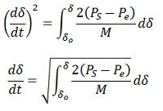
Transient Stability
Rearranging, multiplying by dt and integrating, we have

Slide 5

Transient Stability
Where δ_{o}, is the torque angle at which the machine is operating while running at synchronous speed under normal conditions. Under the above conditions, the torque angle was not changing i.e. before the disturbance.
Also, if the system has transient stability the machine will again operate at synchronous speed after the disturbances, i.e.,

Slide 6



Transient Stability
Hence the condition for the transient state stability is given by the equation
The area A₁ represents the kinetic energy stored by the rotor during acceleration, and the A₂ represents the kinetic energy given up by the rotor to the system, and when it is all given up, the machine has returned to its original speed.

Slide 7
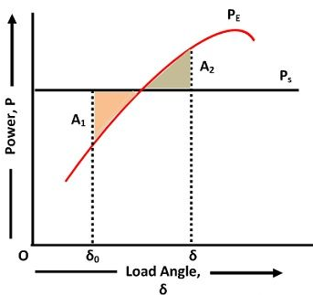
Transient Stability

Slide 8
Transient Stability
The area under the curve P_{A} should be zero, which is possible only when P_{A} has both accelerating and decelerating powers, i.e., for a part of the curve P_{S}> P_{E} and for the other P_{E}> P_{S}. For a generation action, P_{S}> P_{E} for the positive area and A₁> P_{S} for negative areas A₂ for stable operation. Hence the name equal area criterion.
The equal area criterion is also used for determining the maximum limit on the load that the system can take without exceeding the stability limit. This can happen only when the area between the P_{S} line and the P_{E} curve is equal to the area between the P_{S} line, and the P_{E} curve is equal to the area between the initial torque angle δ₀ and the line P_{S}. In this case, the area A₂ is less than the area A₁; the system will become unstable.

Slide 9
Transient Stability
The problems associated with the transient stability of the system is because of the following reasons. These are as follows
Sudden change in load
Switching off one of the lines which cause a change in the reactance of the system and hence a change in load conditions.
Sudden fault on the system which causes the reduction in output, requiring an arrangement for clearance for the clearance of the fault rapidly, and study of after fault condition which may cause part of the system outage.

Slide 10
Transient Stability
In each case, the procedure will be to determine the power angle curve for the initial conditions of the system, for the conditions under fault, and for the after fault condition and plot the curve in per unit value. Then locate the points for the load initial conditions finding out δ_{o}. Then, using equal area criterion, determine the new angle of displacement δ. The maximum angle δ_{max} which may be allowed and the corresponding maximum permissible load can also be determined
Become Next, we can assume the line to be reclosed at load angle, δ_{c}. In this case, the area of acceleration is bigger than area of deceleration. A₁ > A₂.

Slide 11
Transient Stability
The load angle of the generator will pass the point δ_{m}. Beyond this point, the mechanical power is greater than electrical power and it forces the accelerating power to remain positive. Before slowing down, the generator therefore gets accelerate. Consequently, the system will unstable. When A₂ > A₁, the system will decelerate entirely before getting accelerated again. Here, the rotor inertia will force the successive acceleration and deceleration areas to become smaller than the previous ones. Consequently, the system will reach steady state.
When A₂ = A₁, the margin of the stability limit is defined by this condition. Here, the clearing angle is given by δ_{cr}, the critical clearing angle. Since, A₂ = A₁. We get

Slide 12

Transient Stability
The critical clearing angle is related to the equality of areas, it is termed as equal area criterion. It can be used to find out the utmost limit on the load which the system can acquire without crossing the stability limit.

Slide 13

Transient Stability
Consider the system of Example 9.1. Let us assume that the system is operating with P_{m} = P_{e} = 0.9 per unit when a circuit breaker opens inadvertently isolating the generator from the infinite bus. During this period the real power transferred becomes zero. From Example 9.1 we have calculated δ₀ = 23.96 ° = 0.4182 rad and the maximum power transferred as
Consider the system of Example 9.1. Let us assume that the system is operating with P_{m} = P_{e} = 0.9 per unit when a circuit breaker opens inadvertently isolating the generator from the infinite bus. During this period the real power transferred becomes zero. From Example 9.1 we have calculated δ₀ = 23.96 ° = 0.4182 rad and the maximum power transferred as
We have to find the critical clearing angle.
From above the accelerating area is computed as by note that P_{e} = 0 during this time. This is then given by

Slide 14


Transient Stability
To calculate the decelerating area we note that δ_{m} = π - 0.4182 = 2.7234 rad. This area is computed by noting that P_{e} = 2.2164 sin(δ ) during this time. Therefore

Slide 15


Transient Stability
Equating A₁ = A₂ and rearranging we get
let us choose the system frequency as 50 Hz such that ω_{s} is 100π. Also let us choose H as 4 MJ/MVA. Then with δ_{cr} being 1.5486 rad, δ₀ being 0.4182 rad and P_{m} being 0.9 per unit, we get the following critical clearing time

Slide 16

Transient Stability
To illustrate the response of the load angle δ , the swing equation is simulated in MATLAB. The swing equation of is then expressed as
where Δω_{r} is the deviation for the rotor speed from the synchronous speed ω_{s} . It is to be noted that the swing equation of does not contain any damping. Usually a damping term, that is proportional to the machine speed Δω_{r}, is added with the accelerating power. Without the damping the load angle will exhibit a sustained oscillation even when the system remains stable when the fault cleared within the critical clearing time.

Slide 17
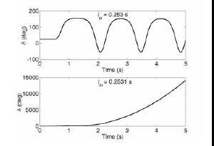
Transient Stability

Slide 18
Transient Stability
Fig. depicts the response of the load angle δ for two different values of load angle. It is assumed that the fault occurs at 0.5 s when the system is operating in the steady state delivering 0.9 per unit power. The load angle during this time is constant at 23.96° . The load angle remains stable, albeit the sustained oscillation when the clearing time t_{cl} is 0.253 s. The clearing angle during this time is 88.72° . The system however becomes unstable when the clearing time 0.2531s and the load angle increases asymptotically. The clearing time in this case is 88.77° . This is called the Loss of Synchronism. It is to be noted that such increase in the load angle is not permissible and the protection device will isolate the generator from the system.
The clearing time of (8.20) is derived based on the assumption that the electrical power P_{e} becomes zero during the fault as in

Slide 19
Transient Stability
This need not be the case always. In that even we have to resort to finding the clearing time using the numerical integration of the swing equation. See example 9.5 to illustrates the point.
Consider the system in which a generator is connected to an infinite bus through a double circuit transmission line as shown in Fig. 9.5. The per unit system reactances that are converted in a common base, are also shown in this figure. Let us assume that the infinite bus voltage is 1< 0° . The generator is delivering 1.0 per unit real power at a lagging power factor of 0.9839 to the infinite bus. While the generator is operating in steady state, a three-phase bolted short circuit occurs in the transmission line connecting buses 2 and 4 - very near to bus 4. The fault is cleared by opening the circuit breakers at the two ends of this line. We have to find the critical clearing time for various values of H .

Slide 20
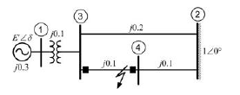


Transient Stability
Let the current flowing through the line be denoted by I . Then the power delivered to the infinite bus is
From the above equation we get

Slide 21
Transient Stability
The total impedance during the time when both the lines are operational, the impedance between the generator and the infinite bus is j(0.3+0.1+0.1) = j 0.5 per unit. Then the generator internal voltage is
Therefore the machine internal voltage is E' = 1.2 per unit its angle is 24.625° or 0.4298 rad.
The pre-fault equivalent circuit is shown in . From this figure we can write the power transfer equation as

Slide 22


Transient Stability
Once the fault is cleared by opening of the breakers connected near buses 2 and 4, only of one the two lines will be operational. Therefore during the post fault period, the impedance between the generator and the infinite bus is j (0.3+0.2+0.6) = j 0.5 per unit as shown in Fig. 9.6 (b). Then the post-fault power transfer equation is given by

Slide 23

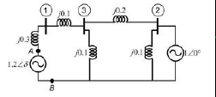
Transient Stability ( CONT…..)

Slide 24

Transient Stability
It is to be noted that since one of the two lines is functional during the fault, the power transfer during the fault will not be zero. The equivalent circuit during the fault is shown in Fig. 9.7. Since the fault has occurred very near to bus-4, we can assume that this bus has been short circuited. We shall find the Thevenin equivalent of the portion of the circuit to the right of the points A and B .
The circuit between buses 2 and 3 has been converted into an equivalent Y using Δ-Y transformation. This is shown in Fig. . From this figure we find the Thevenin impedance as

Slide 25


Transient Stability
Also the Thevenin voltage is then given by
The reduced circuit is shown in Fig. 9.8 (b). From this circuit we can write the following power transfer equation during the fault

Slide 26
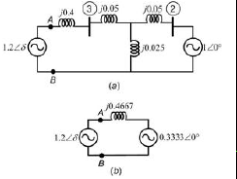
Transient Stability
Three power-angle curves are shown in Fig. . From this figure we find that

Slide 27

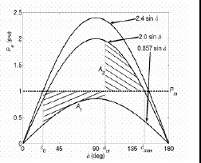
Transient Stability

Slide 28


Transient Stability
The accelerating area is given by
and the decelerating area is

Slide 29

Transient Stability
Equating the two areas we get
As mentioned earlier, the critical clearing angle depends on the system network configuration. The critical clearing time, however, is dependent on H and will vary as this parameter varies. Usually numerical methods are employed for finding out the clearing time. We shall however demonstrate the effect of H through a MATLAB program. The program uses the built-in ordinary differential equation solver though which the swing equations are solved.

Slide 30

Transient Stability
The results obtained are listed in Table . It can be seen that as the value of H increases, the clearing time also increases, even though the clearing angle remains the same. This is obvious as the value of H increases, the response of the system becomes more sluggish due to larger inertia. Hence, the rotor takes more time to accelerate.

Slide 31
Transient Stability
Critical Clearing Angle
The critical clearing angle is defined as the maximum change in the load angle curve before clearing the fault without loss of synchronism. In other words, when the fault occurs in the system the load angle curve begin to increase, and the system becomes unstable. The angle at which the fault becomes clear and the system becomes stable is called critical clearing angle.
When the initial load is given, then there is a critical clearing angle, and if the actual clearing angle exceeds a critical clearing angle, the system becomes unstable otherwise it is stable. Let the curve A represents the power angle curve for a healthy condition;

Slide 32
Transient Stability
curve B represents the power angle curve for faulty condition and curve C represents the power angle curve after isolation of fault as shown below.
Where γ₁ is the ratio of system reactance in healthy condition to that of during the fault and γ₂ is the ratio of steady state limit of the system after the isolation of fault and that of system under the initial condition.
For transient stability limit, two areas A₁ = A₂ or in other words the area under curve adec (rectangle) is equal to the area under the curve da’b’bce.

Slide 33
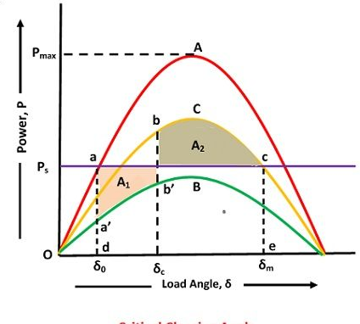
Transient Stability

Slide 34


Transient Stability
Now substituting,
we have,

Slide 35




Transient Stability
Also from the curves

Slide 36
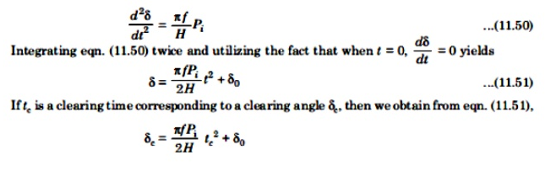
Transient Stability
Thus if γ₁, γ₂, and δ₀ are known, the critical clearing angle δc can be determined.

Slide 37

Transient Stability
Numerical Solution of Swing Equation
There are several sophisticated methods for solving the swing equation. The step-by-step or point-by-point method is conventional, approximate but well tried and proven method. This method determines the changes in the rotor angular position during a short interval of time.
Consider the swing equation:

Slide 38
Transient Stability
The solution δ(t) is obtained at discrete intervals of time with interval spread of Δt uniform throughout.
Accelerating power, P_{A} and change in speed, which are continuous function of time and are described as below:
1. The accelerating power P_{A} computed at the beginning of an interval is assumed to remain constant from the middle of the preceding interval to the middle of the interval being considered, as illustrated in Fig.
2. The angular rotor velocity ω’, i.e., dδ/dt (over and above synchronous velocity ω₀) is assumed to remain constant throughout any interval at the value computed for the middle of the interval, as illustrated in Fig.

Slide 39
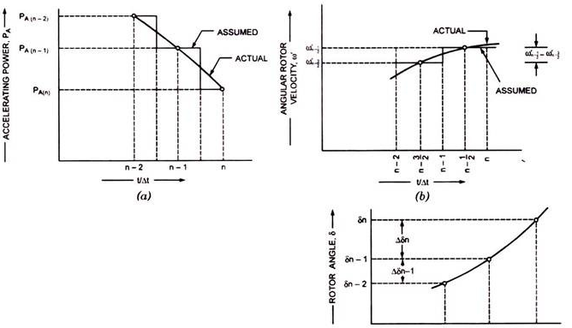
Transient Stability

Slide 40

Transient Stability
The equation for accelerating power at the end of the (n – 1)^{th} interval or for nth interval can be written as –
where δ_{n – 1} has been earlier calculated.
The change in velocity caused due to P_{A (n – 1)} assumed to remain constant over Δt from (n – 3/2) to (n – 1/2),
The above process of computation is repeated to obtain P_{A}(n), Δδ_{n + 1} and δ_{n + 1}. The time solution in discrete form is thus carried out over the desired length of time, usually 0.05 second. Actual swing curve can be plotted by drawing a smooth curve through discrete values, as shown in Fig.

Slide 41
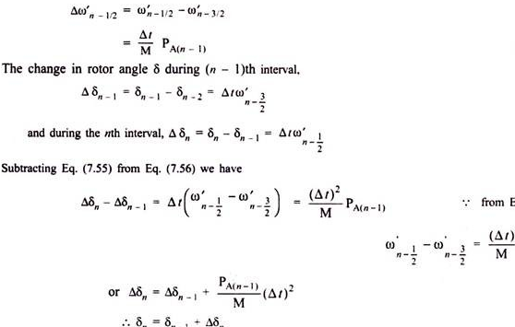
Transient Stability

Slide 42
Transient Stability
The accuracy of the solution depends upon the time duration of the intervals. As the time interval is reduced the computed swing curve approaches the true. Usually Δt = 0.05 second provides good accuracy in results. The occurrence or removal of a fault or initiation of any switching action causes a discontinuity in accelerating power.
There are three possibilities of occurrence of discontinuity:
The discontinuity occurs at the beginning of the nth interval,
(ii) The discontinuity occurs at the middle of an interval.

Slide 43
Transient Stability
(iii) The discontinuity occurs at some time other than the beginning or the middle of an interval.
In the first case, the average of the values of accelerating power P_{A} before and after discontinuity should be used. Thus in determining the increment of angle occurring during the first interval after the occurrence of fault at t = 0, Eq. (7.57) becomes –
Δδ_{i} = P_{A°+} /2M (Δt)²
whereas P_{A°+} is the accelerating power immediately after the occurrence of the fault. Since immediately before the occurrence of the fault the system is in steady state, P_{A°-} = 0 and δ₀ is of known value.
If the fault is cleared at the beginning of the nth interval, in calculation for this interval the value of P_{A(n – 1)} should be taken as –

Slide 44

Transient Stability
where P_{A (n-1)-} is the accelerating power immediately before clearing and P_{A (n – 1)+} is that immediately after clearing the fault.
In second case, i.e., when the discontinuity occurs at the middle of an interval, no special procedure is required. The increment of the angle during such an interval is computed, as usual, from the value of P_{A} at the beginning of the interval, i.e.,
P_{A} = P_{s} – output during the fault
Where-as at the beginning of the interval following clearing of the fault, P_{A} is given as –
P_{A} = P_{s} – output after clearance of fault.

Slide 45
Transient Stability
compute accelerating power P_{A} in the third case, a weighted average value of P_{A} before and after the discontinuity may be used. It is found in practice that such a precise computation of accelerating power P_{A} is not required as the time interval used in computation is so short that it is sufficiently accurate to consider the discontinuity to occur at the beginning or at the middle of an interval and accelerating power P_{A} is computed as outlined above in the first two cases.

Slide 46
Transient Stability
The methods often employed in practice
to improve system stability are:
Increasing System Voltage: ...
Reduction in Transfer Reactance: ...
Using High Speed Circuit Breaker: ...
Automatic Reclosing: ...
Transient Stability: ...
Turbine Fast Valving: ...
Application of Braking Resistors: ...
Single Pole Switching:

Slide 47
Transient Stability
Transient stability can be improved either by using machines of higher inertia or by connecting the synchronous motors to heavy flywheels. This method, however, cannot be used in practice because of economic reasons and reasons of excessive rotor weight.
On contrary, the modern trend in generator design is to achieve more power from smaller machines and hence lighter rotors. Improved methods of generator cooling have helped in this process. However, this trend is undesirable from the point of view of stability. A salient-pole generator operates at lower load angles and is, therefore, preferred over cylindrical rotor generators for consideration of stability.

Slide 48
Transient Stability
Now more emphasis and reliance is placed on controls to provide the required compensating effects with which we may be able to offset the reduction in stability margins inherent from above trends in generator design. With the advent of high-speed circuit breakers, high-speed excitation systems and fast valving the loss in stability margin has been made up.
The methods often employed in practice to improve system stability are:
1. Increasing System Voltage:
Transient stability is improved by raising the system voltage profile, (i.e., raising E and V). Increase in system voltage means the higher value of maximum power, P_{max} that can be transferred over the lines.

Slide 49
Transient Stability
Since shaft power, P_{s} = P_{max} sin δ, therefore, for a given shaft power initial load angle δ ₀ reduces with the increase in P_{max} and thereby increasing difference between the critical clearing angle and initial load angle.
Thus machine is allowed to rotate through large angle before it reaches the critical clearing angle which results in greater critical clearing time and the probability of maintaining stability.
2. Reduction in Transfer Reactance:
Transient stability can also be improved by reducing the transfer reactance,. The effect of reducing the transfer reactance means increase of P_{max} resulting in increase in transient stability.

Slide 50
Transient Stability
The line reactance can be reduced by using more lines in parallel instead of a single line. In general, more power is transferred during a fault on one of the lines if there are two lines in parallel, than that would be transferred over a single faulted line.
Increased power transfer means less available accelerating power, because the accelerating power is the difference between power input and power transfer. Lower accelerating power reduces the risk of instability. The use of bundled conductor lines also helps in reducing line reactance and improving stability.
The compensation of line reactance by series capacitors is another method of improving stability. For lines longer than 325 km this method has proved economical as a means of increasing stability.

Slide 51
Transient Stability
The use of shunt reactors will reduce the danger of instability on lightly loaded lines. If saturable reactors are used, the regulation can be maintained steady over a wide range of loads.
Increasing the X/R ratio increases the power limit of the line itself, which in turn aids stability.
3. Using High Speed Circuit Breaker:
The best method of improving transient stability is the use of high-speed circuit breakers. The quicker a breaker operates, the faster the fault is removed from the system and better is the tendency of the system to restore to normal operating conditions. The use of high-speed breakers has materially improved the transient stability of the power systems and does not require any other method for the purpose.

Slide 52
Transient Stability
Use of high-speed breakers increases the decelerating area A₂ and decreases the accelerating area A₁ and so improves the stability.
3. Using High Speed Circuit Breaker:

Slide 53
Transient Stability
On occurrence of a fault on a transmission line, the faulted line is de-energized to suppress the arc in the fault and then the circuit breaker recloses, after a suitable time interval. Automatic reclosing increases the decelerating area A₂ and thus helps in improving stability.
On occurrence of a fault on a transmission line, the faulted line is de-energized to suppress the arc in the fault and then the circuit breaker recloses, after a suitable time interval. Automatic reclosing increases the decelerating area A₂ and thus helps in improving stability.
4. Automatic Reclosing:
As the majority of faults on the transmission lines are transient in nature and are self-clearing, rapid switching and isolation of faulty lines followed by reclosing are quite helpful in maintaining stability. The modern circuit breaker technology has made it possible for line clearing to be done as fast as in 2 cycles.
On occurrence of a fault on a transmission line, the faulted line is de-energized to suppress the arc in the fault and then the circuit breaker recloses, after a suitable time interval. Automatic reclosing increases the decelerating area A₂ and thus helps in improving stability.

Slide 54
Transient Stability
5. Transient Stability:
It can be improved by reducing the severity of faults which can be achieved by using lightning arresters for protection of the lines.
6. In systems where the stability is of prime importance, high neutral grounding impedance may be used.
The grounding is effective only for unbalanced faults. Zero-sequence impedance comes into picture to restrict the fault current only in case of faults like line-generator to-ground or line-to-line-to-ground. For an electrical system depicted in Fig. (a), the equivalent impedance diagram is shown in Fig.
.

Slide 55
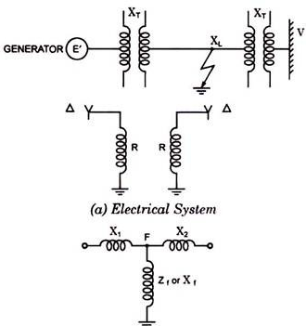
Transient Stability

Slide 56

Transient Stability
The power transfer is given by the expression:
Where X_{f} is equivalent fault-shunt impedance.
Physically the resistance in the neutral of the transformer represents an absorption of electrical energy which in turn reduces the accelerating energy and thus improves the transient stability.
The grounding resistor consumes power during a ground fault and thus exerts braking effect on the synchronous machine which is greater, the closer the fault is to the resistor and closer the machine is to the fault. A grounding resistor located near a generator is, therefore, beneficial.

Slide 57
Transient Stability
However, a grounding resistor should neither be employed near an actual or equivalent synchronous motor nor it should be employed near a synchronous condenser, as such machines already are retarded by faults. In a two machine system, it is, therefore, advisable to have resistance grounding at the sending end and reactance grounding at the receiving end.
7. Turbine Fast Valving:
One reason for power system instability is the excess energy supplied by the turbine during the disturbance period. Fast valving is a means of reducing turbine mechanical input power when a unit is under acceleration due to a transmission system fault. This can be initiated by load impedance relays, acceleration transducers or by relays that recognize only severe transmission system faults.

Slide 58
Transient Stability
For maximum stability gains with fast valving, the turbine input power should be reduced as fast as possible. During a fast valving operation, the interceptor valves are rapidly shut (in 0.1 to 0.2 second) and immediately re-opened. This procedure increases the critical switching time long enough so that in most of the cases the unit will remain stable for faults with stuck-breaker clearing times. Presently some stations in USA have been put to use fast valving schemes.
8. Application of Braking Resistors:
An alternative or supplement to fast turbine valving action is the application of braking resistors. Braking resistors, as employed in the context of electric power system stability, is the concept of applying an artificial electric load to a portion of the generator-transmission load complex to correct a temporary imbalance between power generated and power delivered.

Slide 59
Transient Stability
During a fault the resistors are connected to the terminals of the generator through circuit breakers by means of an elaborate control scheme. The control scheme determines the amount of resistance to be connected and its duration. The braking resistors remain on for a matter of cycles both during fault clearing and after system are restored to normal operation.
A few cycles after the clearance of fault, the same control scheme disconnects the braking resistors. However, the control schemes available are not very reliable. Control schemes using thyristors have recently been suggested. The noteworthy point is that a possible failure or mal-operation of control scheme can make the matter still worse.

Slide 60
Transient Stability
9. Single Pole Switching:
Single pole switching or independent pole operation of a circuit breaker refers to the mechanism with which the three phases of the breaker are closed or opened independently of each other. The failure of any one phase does not automatically prevent any of the two remaining phases from proper operation.
However, for a 3-phase fault, the three phases are simultaneously activated for operation by the same relaying scheme. The three phases are mechanically independent, such that the mechanical failure of any one pole is not propagated for the remaining poles.

Slide 61
Transient Stability
Single pole switching is used at locations where the design criterion is to guard against a three-phase fault compounded with breaker failure. The successful independent pole operation of the failed breaker will reduce a three-phase fault to a single L-G fault (if one pole of the breaker is stuck), or to L-L-G fault (if two poles of the breaker are stuck). This criterion can be applied to the substation of a generating plant with multiple transmission outlets.
The advantages of single poles switching under three phase fault breaker failure contingency are two­fold. First, they are among the cheapest stability aids. Single pole switching operation is most efficient at high transmission voltages where equipment’s are costlier.

Slide 62
Transient Stability
Successful single pole switching may allow the critical clearing time of a plant circuit breaker to increase by as much as 2 to 5 cycles. Second, it is relatively easy to install. Most EHV circuit breakers are equipped with separate pole mechanism due to the large component size and wide phase space requirements at high working voltages. The only additional complexity is to provide separate trip coils to activate each pole.
10. Use of Quick-Acting Automatic Voltage Regulators:
The satisfactory operation of synchronous generators of a complex power system at high power (or load) angles and during transient condition is very much dependent on the source of excitation for the generators and on the automatic voltage regulator.

Slide 63
Transient Stability
The power output of a generator is proportional to internal voltage E. Under fault conditions the terminal voltage V falls. A quick-acting voltage regulator causes increase in E so that the terminal voltage V remains constant. A higher value of E means a higher generator output.
It has already been shown that the maximum value of a power angle curve is proportional to the per unit excitation. Field forcing can, therefore, cause the machine to operate on a higher power-angle curve thereby allowing it to swing through a larger angle from its original position before it reaches the critical clearing angle.

Slide 64
Transient Stability
As an example of the effectiveness of modern high-speed automatic voltage regulators, consider Fig. . Two power-angle curves a and b have been drawn representing two different excitations. Curves of terminal voltage V against rotor angle for the same excitations have also been drawn. Consider working at point B on power angle curve a, where the voltage rotor angle relation is normal.
If we now wish to increase the power input and maintain the same rotor angle, we can do so by increasing excitation, i.e., by working on power angle curve b at point C. Although C is in the static stability limit, the terminal voltage is above normal. However, the same power can be supplied by working at point D, in the inherently unstable region.

Slide 65
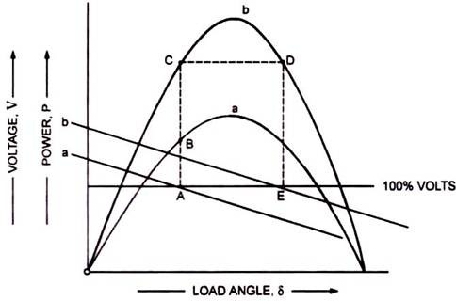
Transient Stability

Slide 66
Transient Stability
If the field current is constant, the slightest difference would cause instability. However, because of the high inertia, the swings are slow, and if an automatic voltage regulator is fitted, it can sense the drop in terminal voltage as the rotor angle is increased. Before the generator has swung an appreciable amount, sufficient boost is given to the field to make the power output greater than the input, thereby arresting the swing and maintaining stability.

